Slide 1


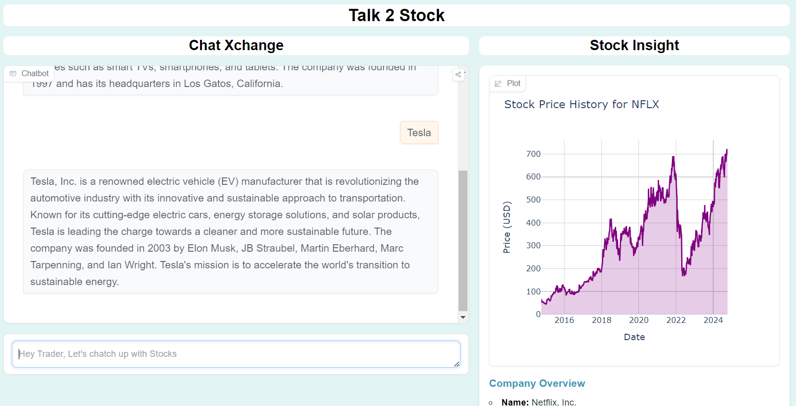


Chat Memory
Function calling

Slide 2
